Slide 1
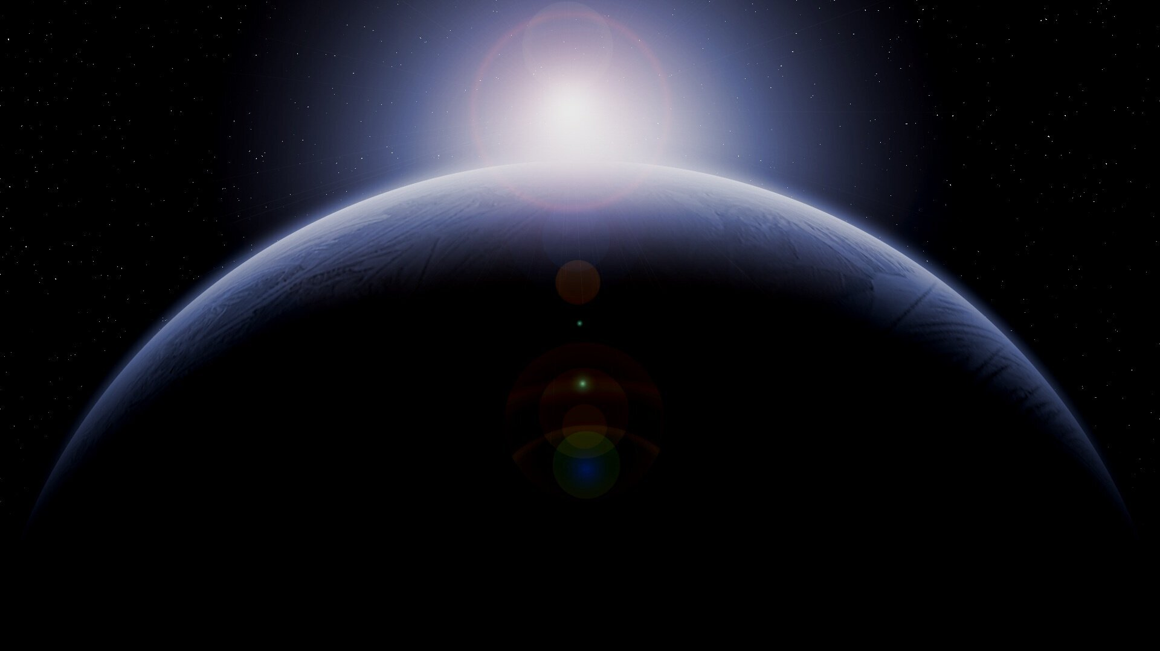

LAST MOON
Galaxies and the Universe | Lamford School

Slide 2
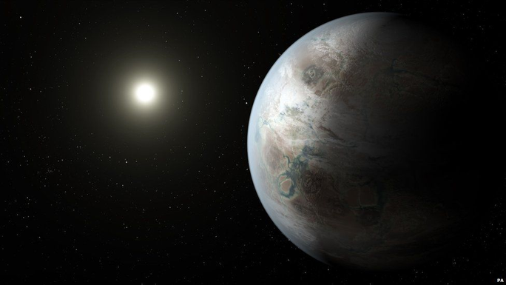
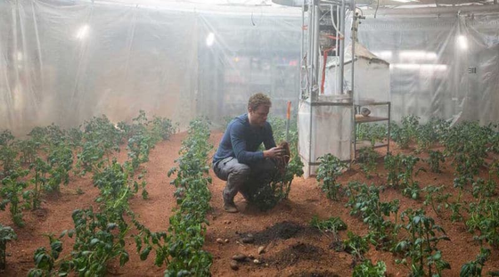
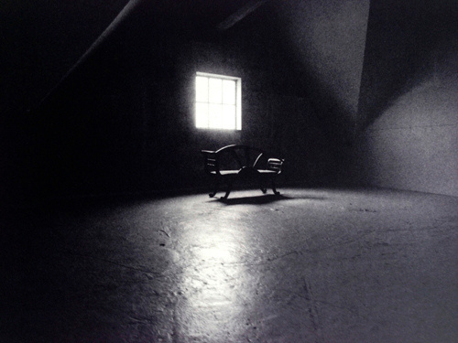

Crushing loneliness
Galaxies and the Universe | Lamford School
You're alone
You're stranded
You have food, shelter, electricity. You can survive, but you're missing something which causes you more suffering than hunger or thirst. You are contemplating suicide.
It's been 4 years since you came to this planet. You have not heard back from Earth. It's Gravity, but this time your friend is with you.
You're waiting
Ever since the last moon, roughly 281 hours ago, you haven't seen your partner.

Slide 3
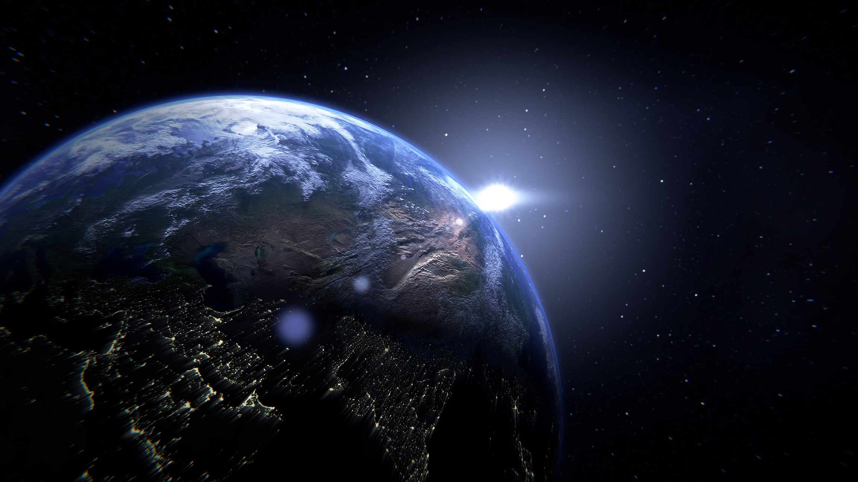
Just 5 hours before the next moon
Galaxies and the Universe | Lamford School
You told yourself you will wait, but as the next moon is coming, you set out to understand what has happened to your friend. The same environment, you reminisce about the day and find clues all over the space ship.
OR NO?
The player can choose to end the game at any time by walking out into space.

Slide 4
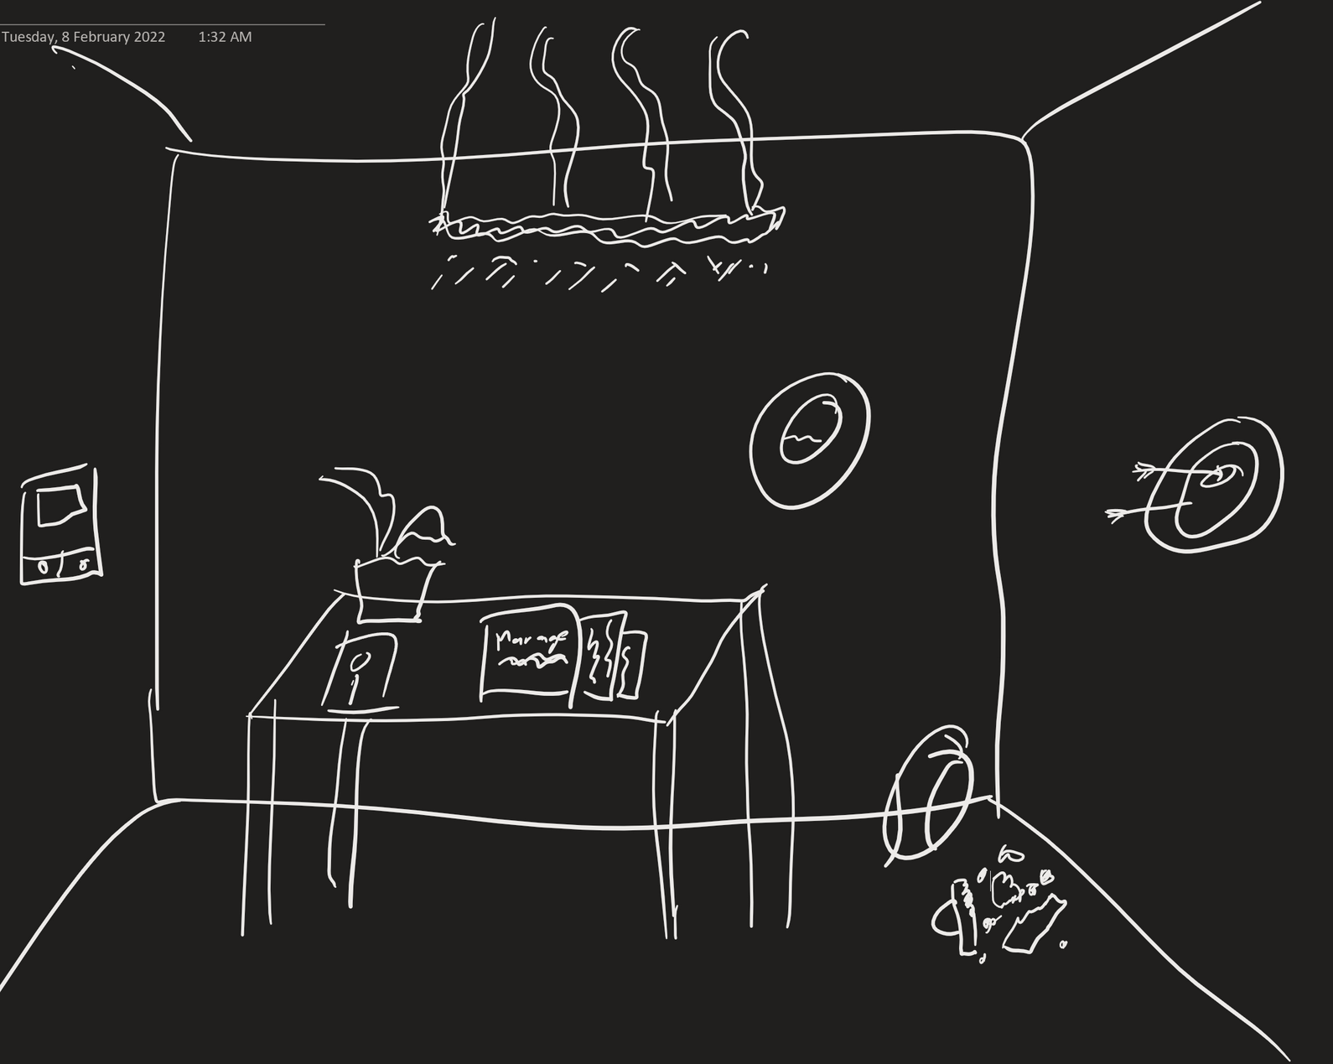
The room

Slide 5
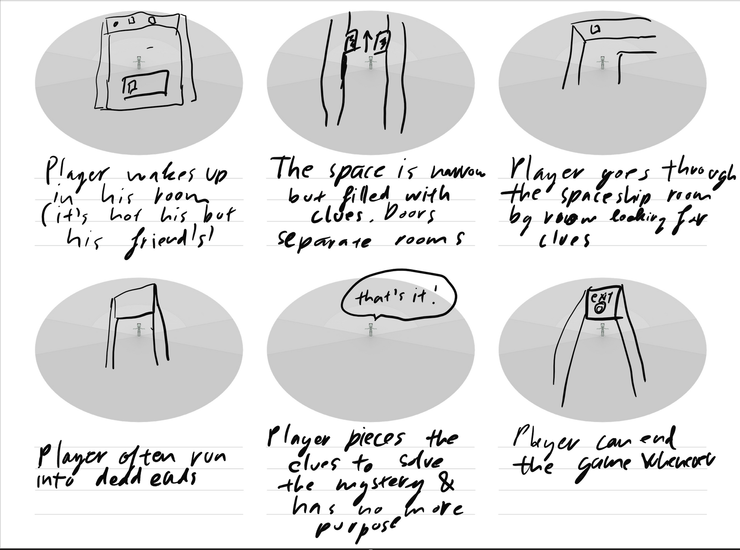

Slide 6
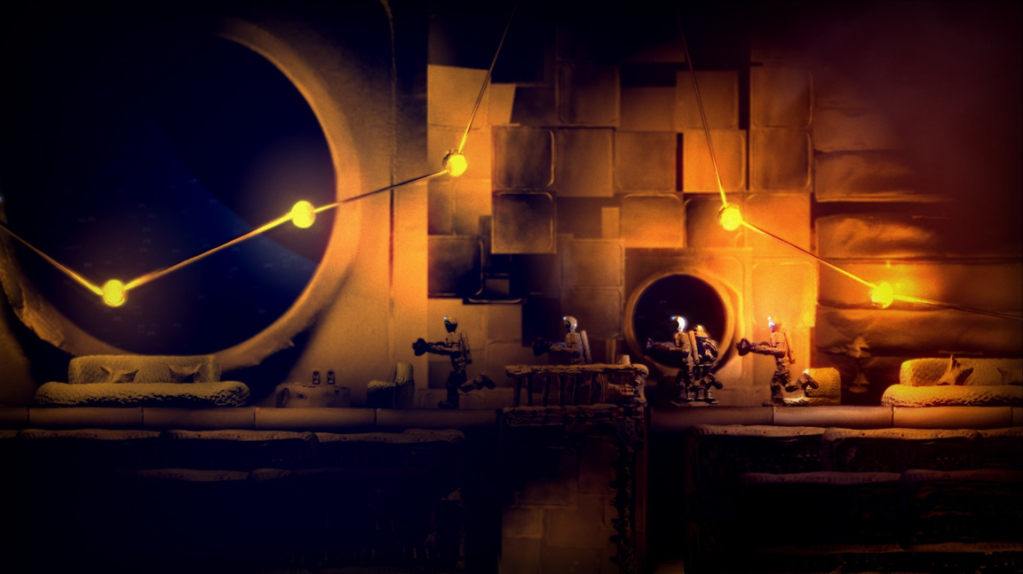
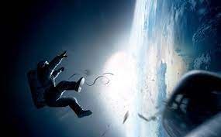
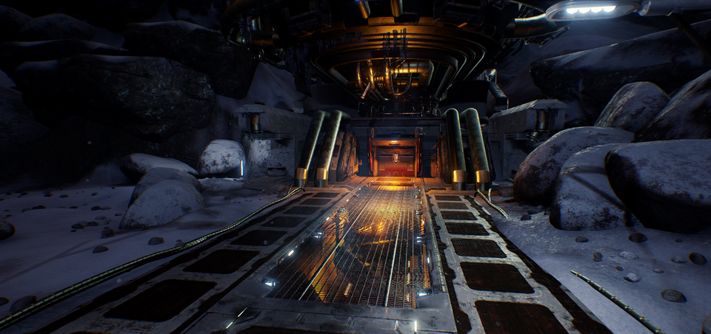



Slide 7
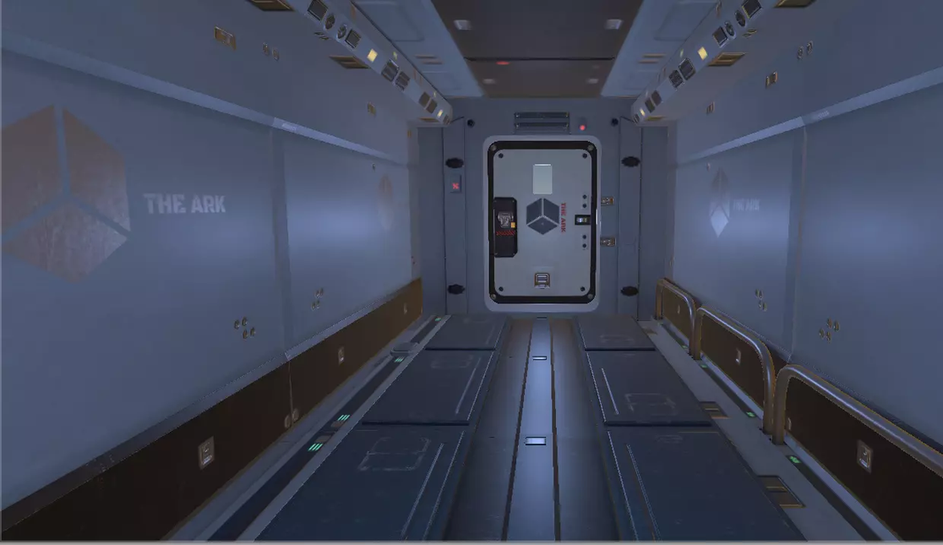
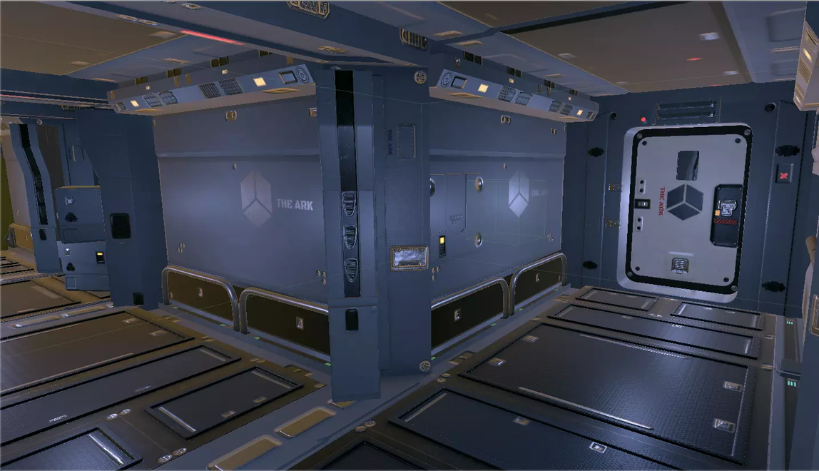
Galaxies and the Universe | Lamford School
Empty corridors
Finding your friend
Spaceship-esque environment from unity asset store:
https://assetstore.unity.com/packages/3d/environments/sci-fi/modular-sci-fi-corridor-142811
Amid feeling of lonliness, you will set out to solve the mystery: where is your partner? What happened?
Work in progress!

